Slide 1
Quantitative Strategy Workflow
Alpha Factors Screening & Synthesis

Slide 2
Preface: Intention
Attempt to answer the question: “ What really drives performance?” For example, APT model is designed to capture the sensitivity of asset returns as a function of multiple factors.
Build a robust and flexible pipeline for factor-based strategies
”Learn, build, share, repeat” --- Investment Philosophy of O’Shaughnessy
Platform: Quantopian

Slide 3
Protocol
Universe Definition
Factor Pool Construction
Alpha Signal Extraction
Portfolio Allocation

Slide 4
Universe Definition
Market Capitalization (Size)
Book-to-Market (Value)
Liquidity
Tradability
Industry & Sector
Credit Rating

Slide 5
Factor Pool Construction: Two Alternative Selection Methods
Statistical Technique for Latent Variables (Multi-Index Model)
Factor Analysis
PCA
Economic Theory for External Influence (Fama-French Model)
Momentum
Volatility
Kalman Filter
Size
Liquidity
Growth
Profitability
Valuation
Financial Leverage

Slide 6


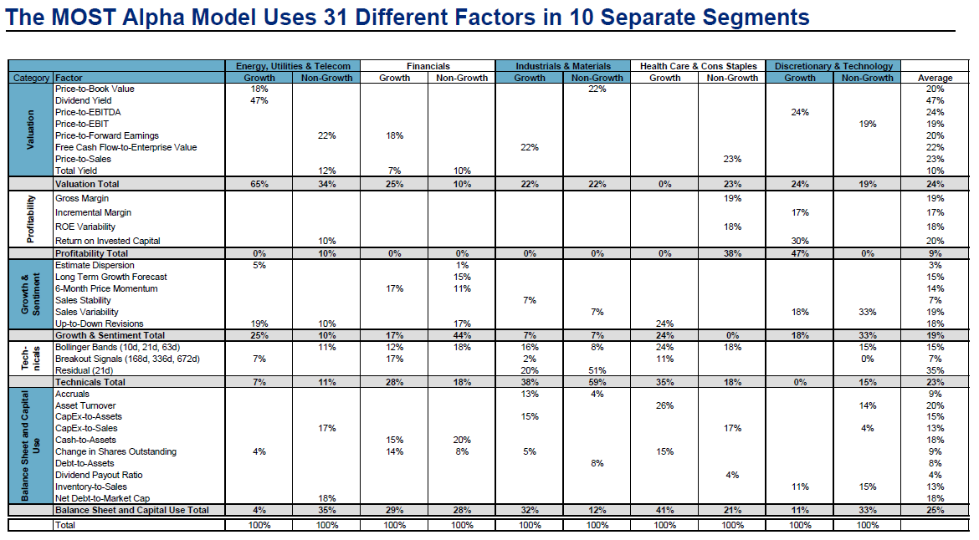

Factor Pool Construction: Goal
z
Question:
How to specify factors for each sector?

Slide 7
Alpha Signal Extraction
Factor Screening:
Choose most significant factors: IC for factors vs. forward returns
Delete the redundant factors: IC between factors
Factor Synthesis
Linear combination:
Statistical techs: PCA, FA
Financial models: APT, Fama-French
Non-linear combination
Machine learning: AdaBoost
Deep learning: Reinforcement learning

Slide 8
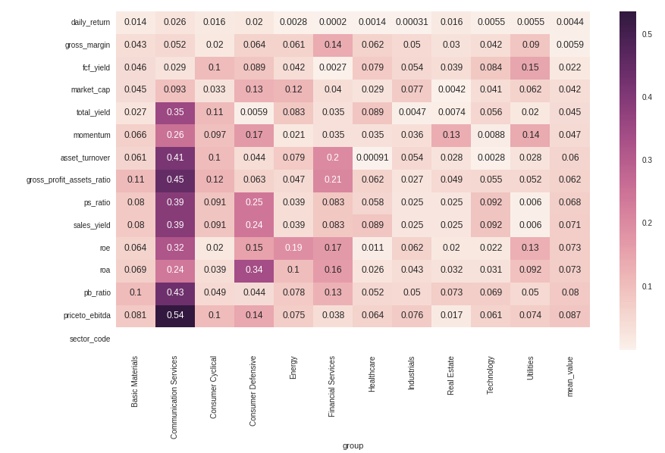
Alpha Signal Extraction: Factor Screening
z
Select factors through economic knowledge
Calculate the information coefficients (IC) for each factor vs. 22-day forward return

Slide 9
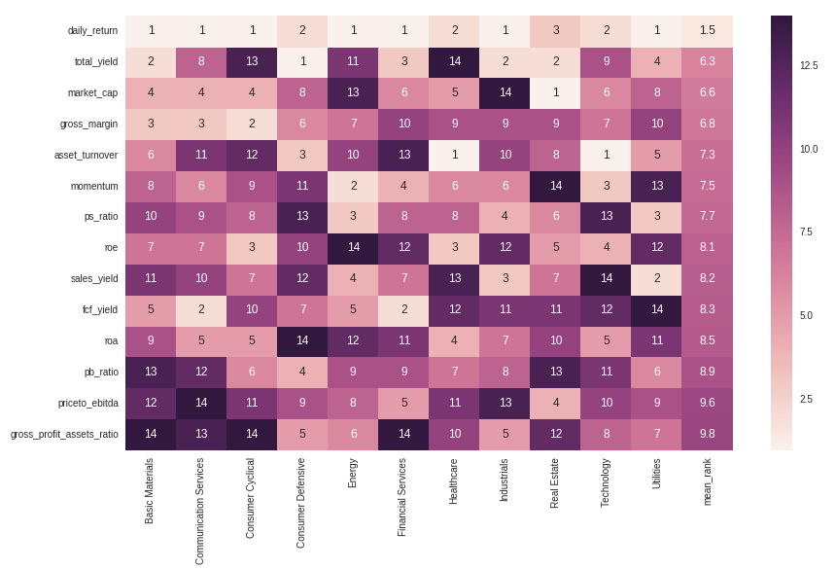
Alpha Signal Extraction: Factor Screening
z
Usually we only care about the ranks (e.g. ascending ranks) rather than the specific numbers

Slide 10
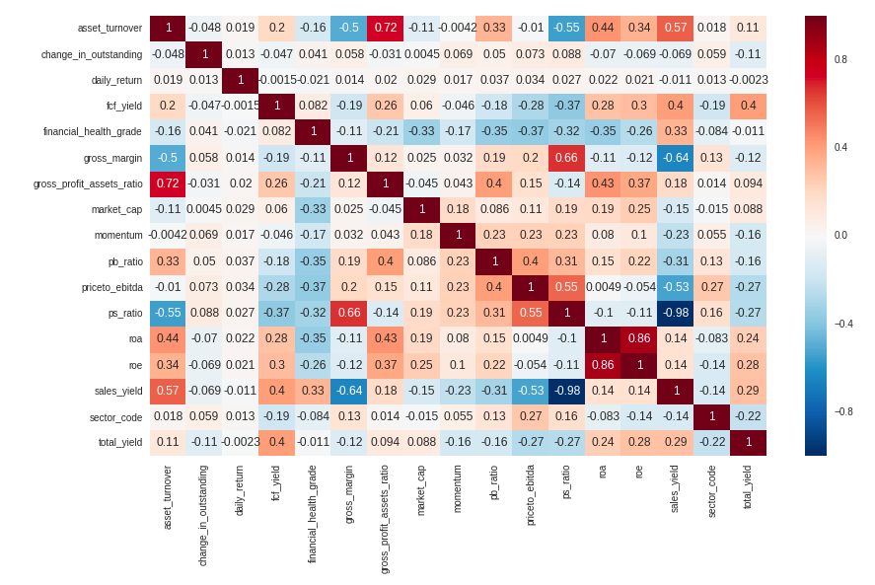

Alpha Signal Extraction: Factor Screening
Spearman’s rank correlation for each factor
Here we don’t want our factors too correlated.
For example, ps_ratio and sales_yield have correlation -0.98
$ps_ratio= Adjusted close price / SalesPreShare$
$sales_yield= SalesPerShare / Price$

Slide 11
Alpha Signal Extraction: AdaBoost
Description
Algorithm
The algorithm sequentially applies a weak classification to modified versions of the data. By increasing the weights of the missclassified observations, each weak learner focuses on the error of the previous one. The predictions are aggregated through a weighted majority vote.

Slide 12
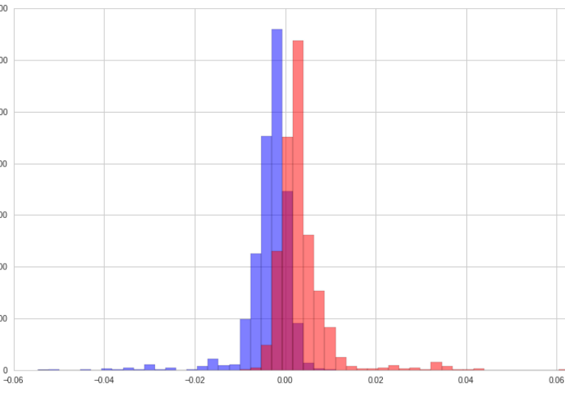
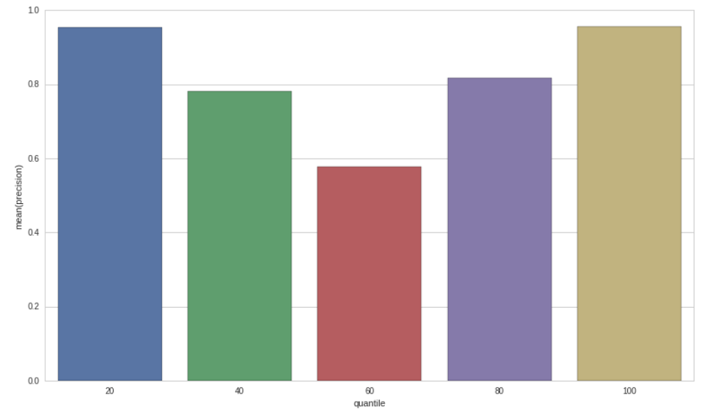
Alpha Signal Extraction: AdaBoost: Train Set
Precision for Each Quantile
Decision Score Histogram
Score
Notes:
Here, I want to find a buy/sell signal for each equity. So I firstly split dataset to train set and test set for train set representing history and test set representing the most recent. The binary signal is defined by a threshold, say, denote the top half as 1 and the bottom half as -1. Then I combined all the factors to train a binary classifier and here is the result.
The first image is the precision along each quantile, we can see it works really well on the extreme score. The second one is the score distribution plot for both classes. Blue class represents equities which have depreciated forward returns and incline to have more negative score which can be interpreted as a sell signal. The red class represents equities which have appreciated forward returns and attempt to have more positive score.
From these plots we can see the binary classifier works really well for the train set. How about the test set?

Slide 13
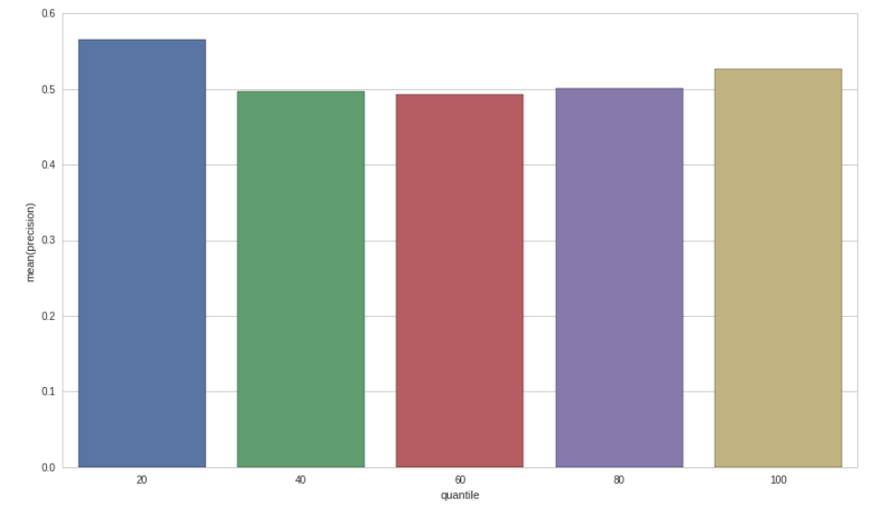
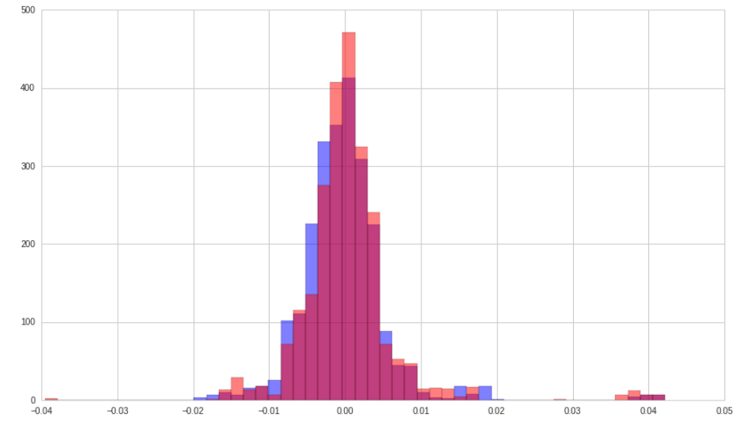
Alpha Signal Extraction: AdaBoost: Test Set
Precision for Each Quantile
Decision Score Distribution
Notes:
The classifier works slightly better in the extreme scenario. Not so well, but better than nothing!

Slide 14
Conclusion
From the results, the foreseeability of this machine learning alpha is just slightly better than 50% and performs stable around different situation. It doesn’t surprise me but better than nothing.
Does that interest you? Any optimization tip on my presentation and workflow?

Slide 15
P&L
Be Continue …

Slide 16
Reference
Jonathan Larkin, A Professional Quant Equity Workflow. August 31, 2016
A Practitioner‘s Guide to Factor Models: The Research Foundation of The Institute of Chartered Financial Analysts
Thomas Wiecki, Machine Learning on Quantopian
Inigo Fraser Jenkins: Using factors with different alpha decay times: The case for non-linear combination
PNC: Factor Analysis: What Drives Performance?
O’Shaughnessy: Alpha or Assets? — Factor Alpha vs. Smart Beta. April 2016
O’Shaughnessy Quarterly Investor Letter Q1 2018

